Slide 1
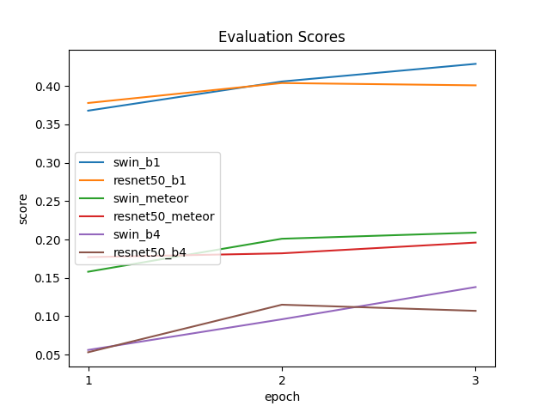

Slide 2
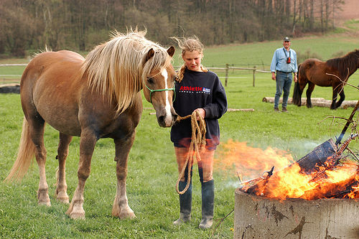
<Start>
A
girl
<end>
Log
Softmax
Log
Softmax
Log
Softmax
Log
Softmax
GRU
GRU
GRU
GRU
Linear
. . .
Input Image
(500x333x3)
CNN-based
or
Transformer-based
Encoder
Feature Vector
(1x1x1000)
<Start>
A
fire

